Slide 1
A STUDY OF MODERN IMAGE UPSCALING METHODS
18BCE0034
R ADITYA SAI

Slide 2
INTRODUCTION
Today’s entertainment industry is majorly involved in use of communication and visualization technologies for function.
And with the rise in imaging technologies, old records are being rendered out of date because they are visually unpleasant or inferior than latest content when viewed through modern displays.
in the past 10 years, with the increase in data storage and processing technologies, the most common display resolutions have risen exponentially.

Slide 3
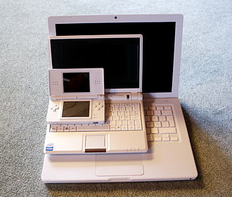
Native resolutions
240p (480 × 240 Standard-definition television SDTV)
480p (720 × 480 Enhanced-definition television EDTV)
720p (1280 × 720 High-definition television HDTV)
1080p (1920 × 1080 Full High-definition television FHDTV)
Ultra-high-definition television (UHDTV)
4K UHD (3840 × 2160 progressive scan)
8K UHD (7680 × 4320 progressive scan)

Slide 4
Problem statement
We need to obtain a digital image with
size much larger than the original image
properties like it had been acquired with a sensor having the resolution of the upscaled image or, at least, appear native to its size.

Slide 5
ENHANCEMENT VS UPSCALING
Image enhancement is the process of adjusting digital images so that the results are more suitable for display or analysis depending on the domain.
Image upscaling also known as super-resolution is a form of image enhancement specific to the domain of infotainment.
The aim of single image super-resolution is to reconstruct a high-resolution image from a single low-resolution input.
In a way, it is the inverse of the downsampling operation or pooling.

Slide 6
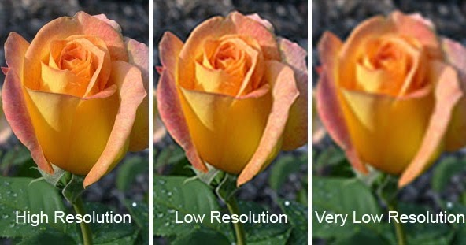
Assumptions
State your assumptions or any unknowns here.

Slide 7
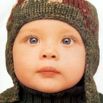
Modern Techniques - original image
128x128

Slide 8
Modern Techniques - enlarged original image
(4x enlargement) 512x512

Slide 9

Modern Techniques - bicubic interpolation

Slide 10

Modern Techniques - Expected High Res Output

Slide 11
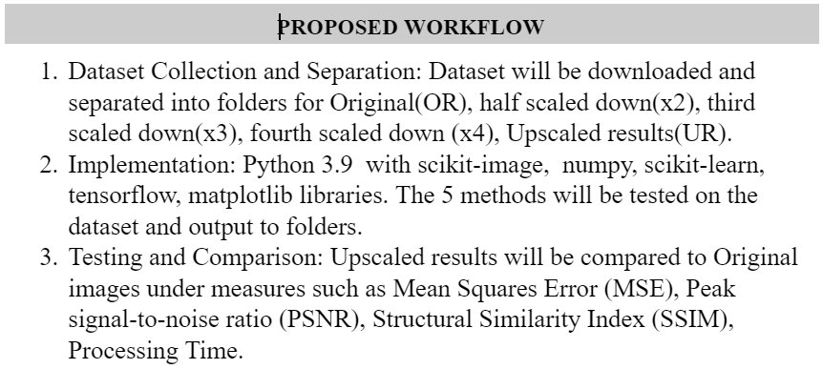

Slide 12
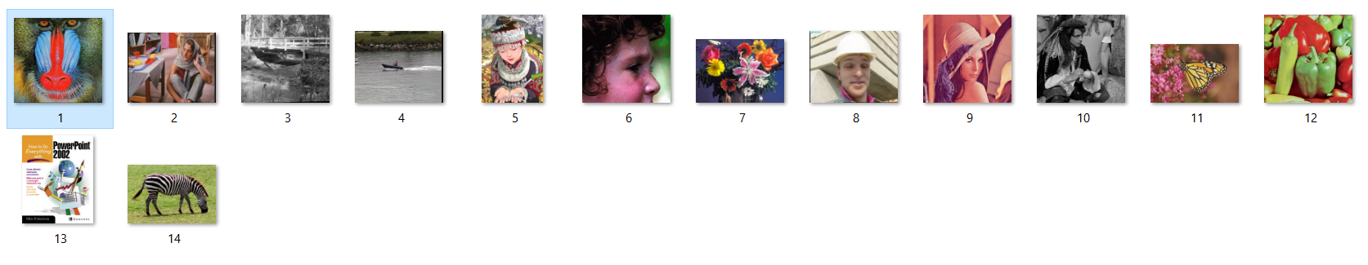
14 image dataset

Slide 13
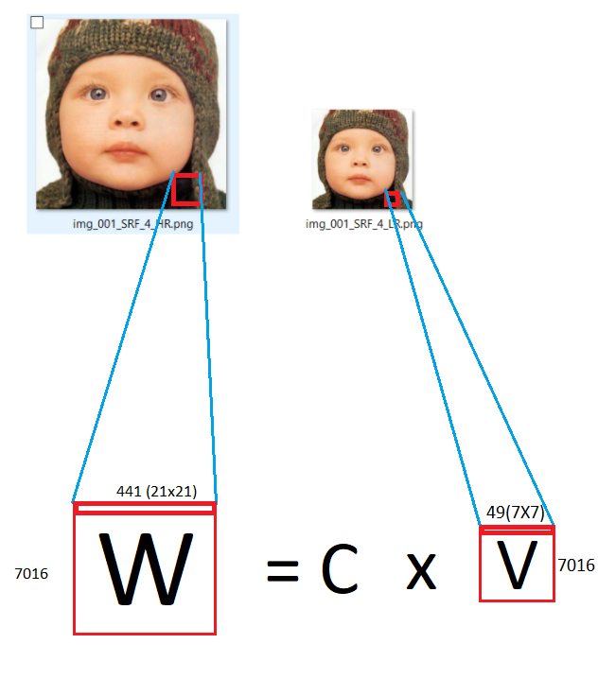
Extracting LR and HR patches from the images

Slide 14
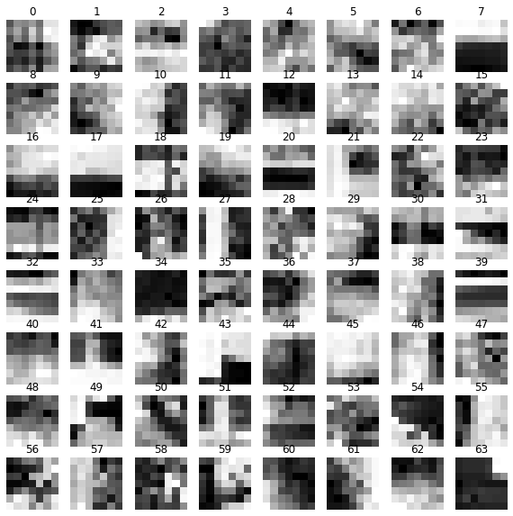
Applying kmeans to cluster the patches into 64 groups

Slide 15

Each LR patch multiplied with C to get High Res Patch

Slide 16
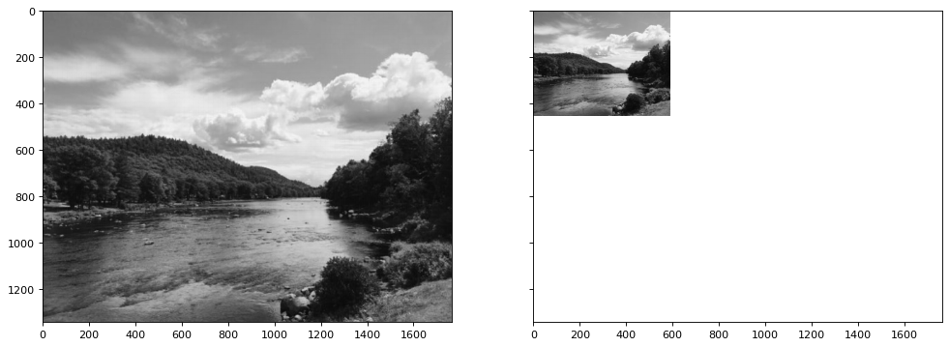
Example Demo after full process

Slide 17
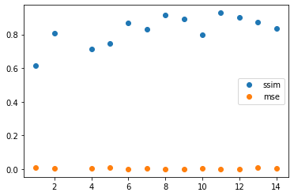
Test Results

Slide 18
THANK YOU

